Slide 1
MPP Library Project
Group 3
01 Sushanta Acharjee 02 Mohammad Nowsher Ali 03 Kallol Chakraborty Shekhor 04 Sumayya Jahan 05 Muhammad Hizbullah Fuad

Slide 2
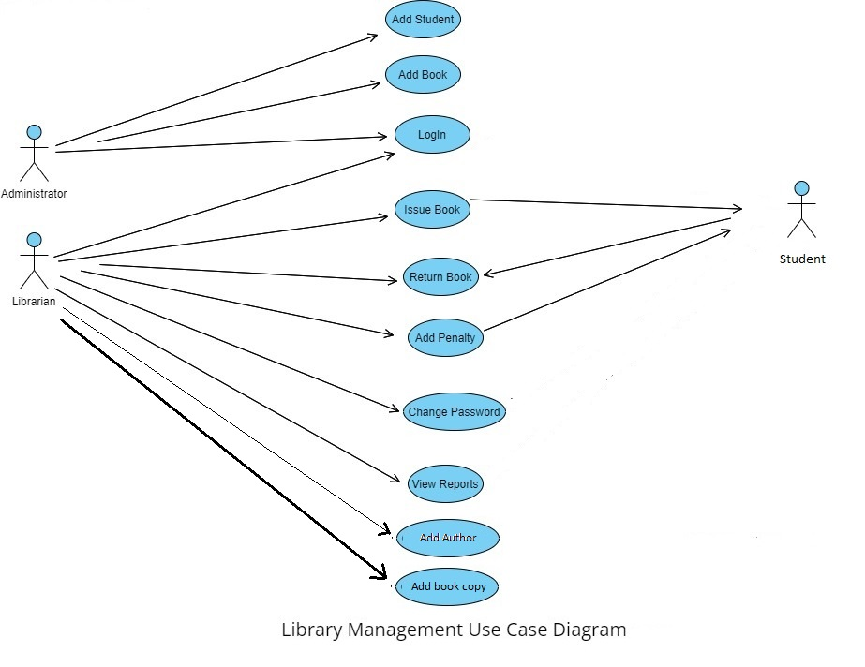
Use Case Diagram

Slide 3
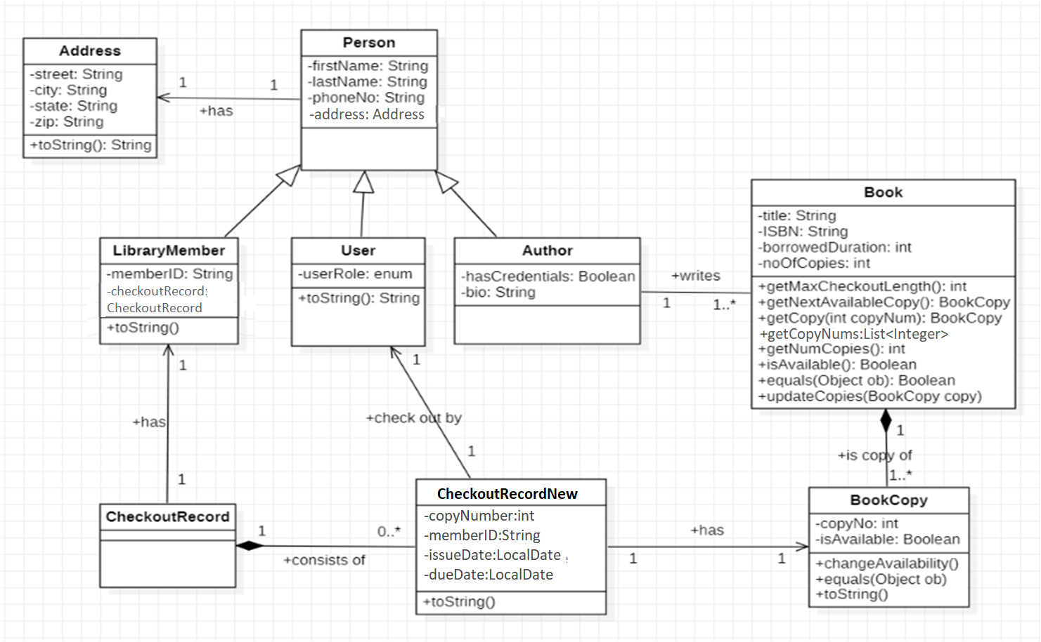
Class Diagram

Slide 4
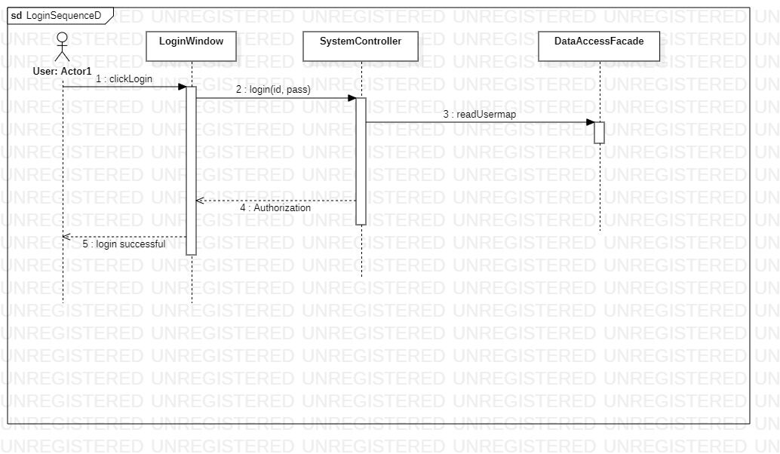
Login Sequence Diagram

Slide 5
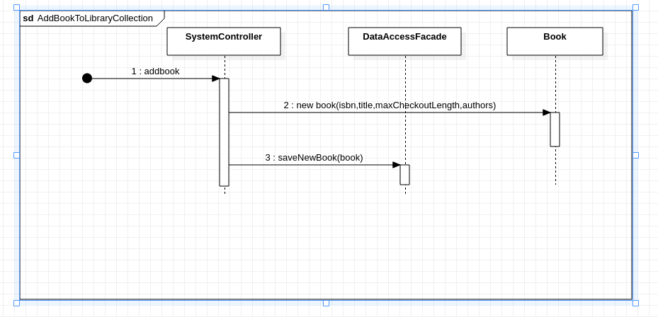
Add Book To Library Collection

Slide 6
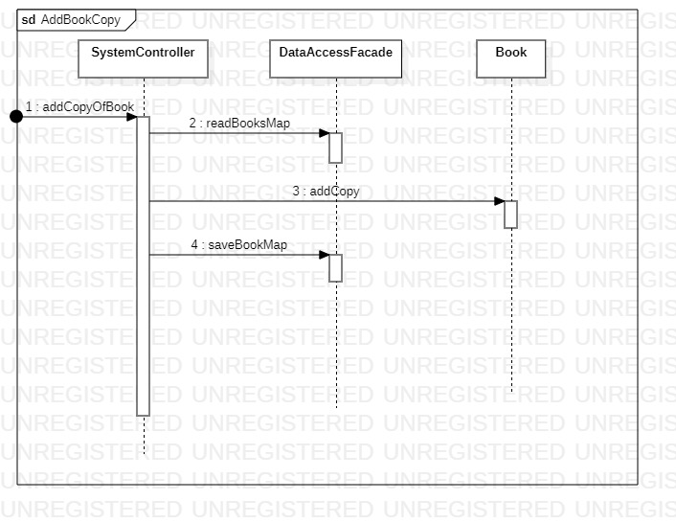
Add Book Copy Diagram

Slide 7
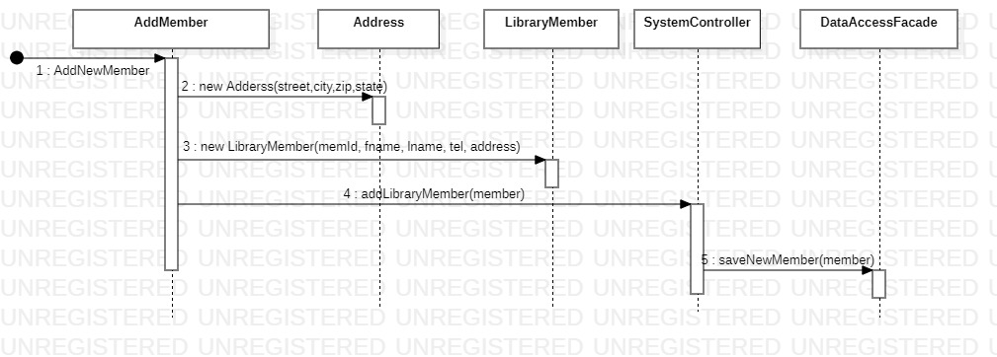
Add New Member

Slide 8
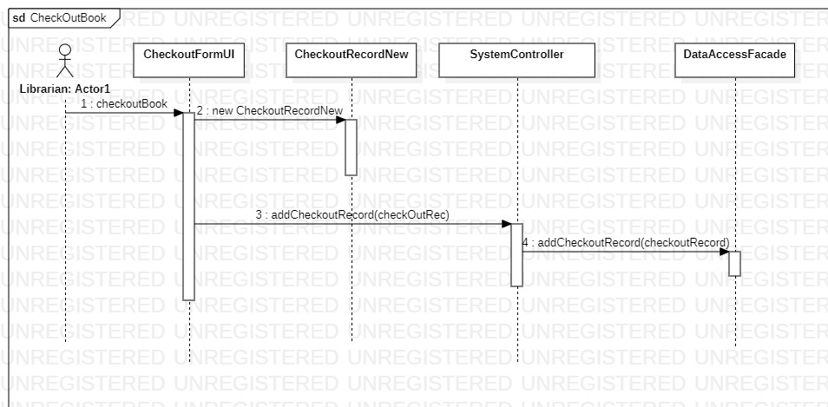
Check Out Book

Slide 9
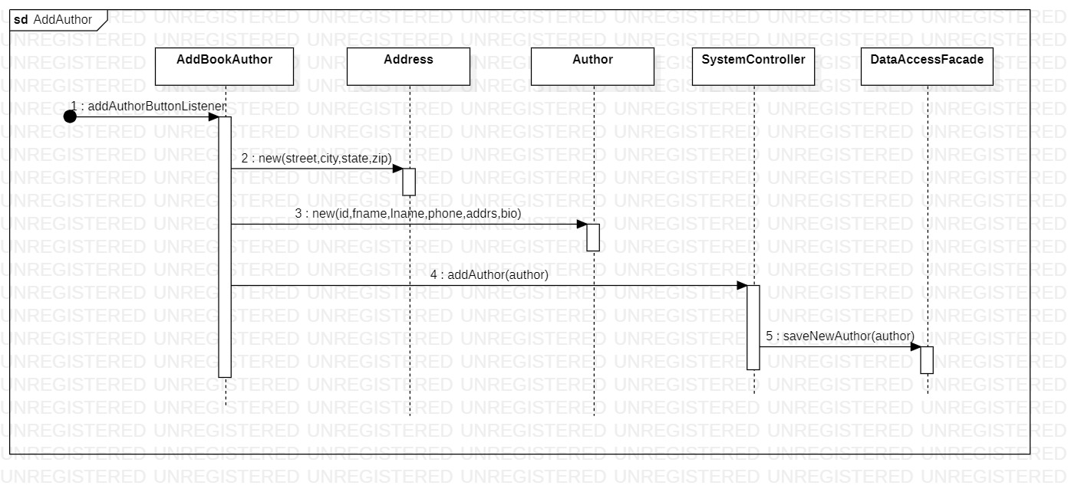
Add Author

